Slide 1
IMMIZEN AUTOMATION APP
A python base app

Slide 2
What can do with this app?
We can take client vital information and store it in online database & we can create an Initial Consultation Agreement.
We can create Service Agreement later with our saved data. In our Service Agreement we can add our customize milestone and client responsibility and also if client have any reference person.
We can create Invoice for client with unique serial number.
We can create Money Receipt for client with unique serial number.
We can create our all four document both docx & pdf. And we save our client data securely.
It can be use both windows & mac we have both version

Slide 3
Information About MVP or UI/UX
This is a python base app. UI/UX is design by Custom Tkinter a update version of Tkinter. Some other library such as python-docx for create docx file, docx2pd for create pdf from docx file, supabase for online database, openpyxl for excel sheet and some other library to complete the entire app.

Slide 4
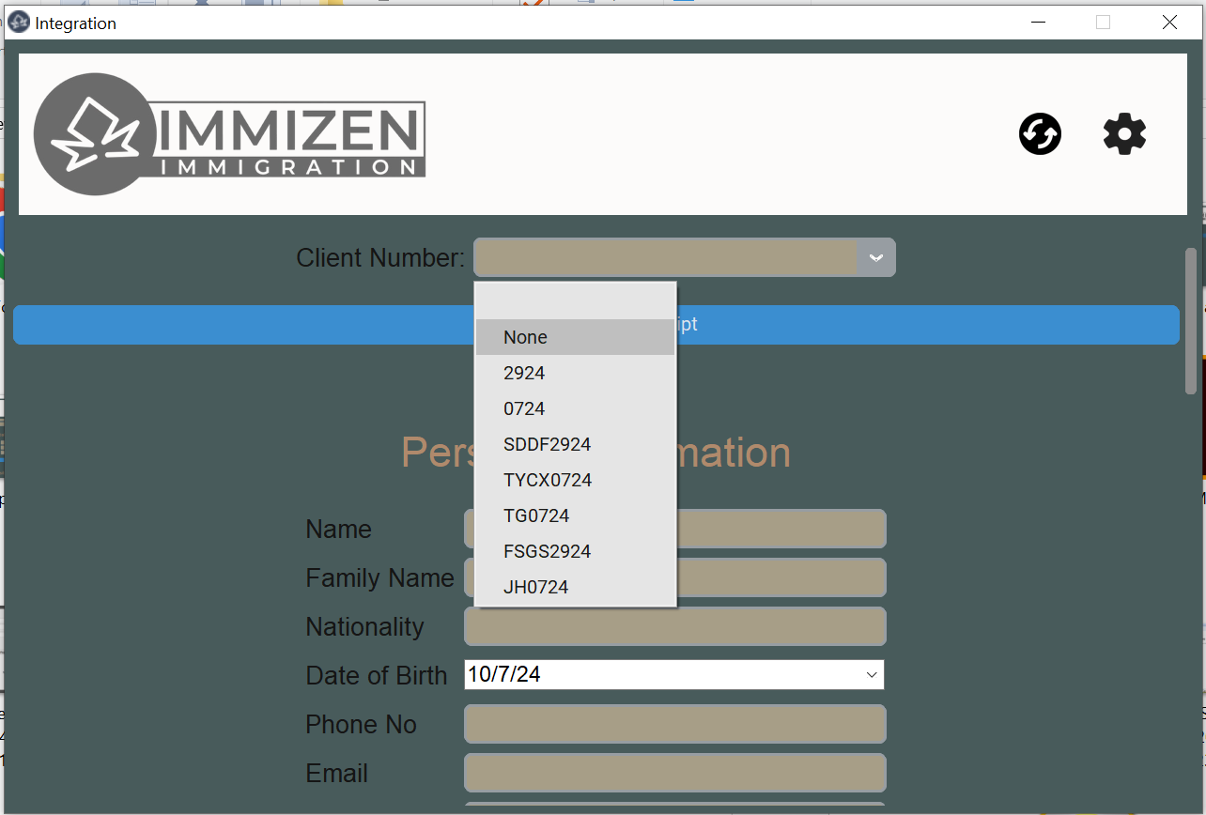
Logo of Company
Refresh Button
Customize Button
Stored Client File
Number Selection
Combo Box or blank
For new

Slide 5
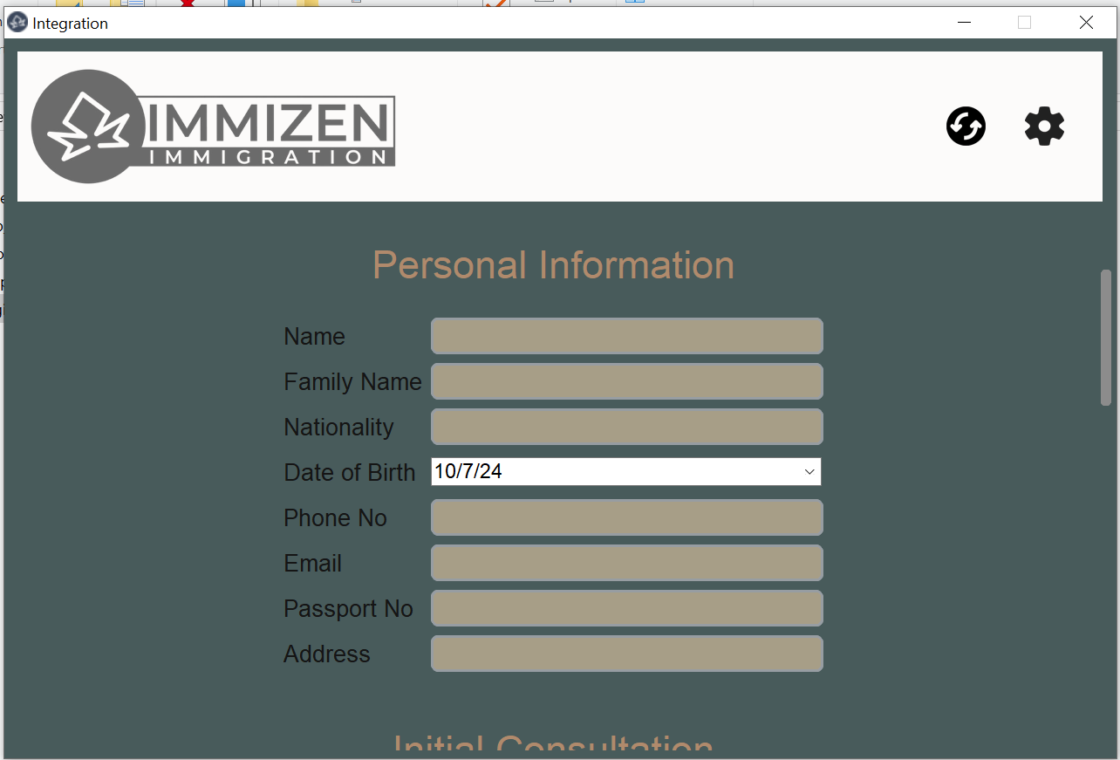
Client personal Information
In Text Box

Slide 6
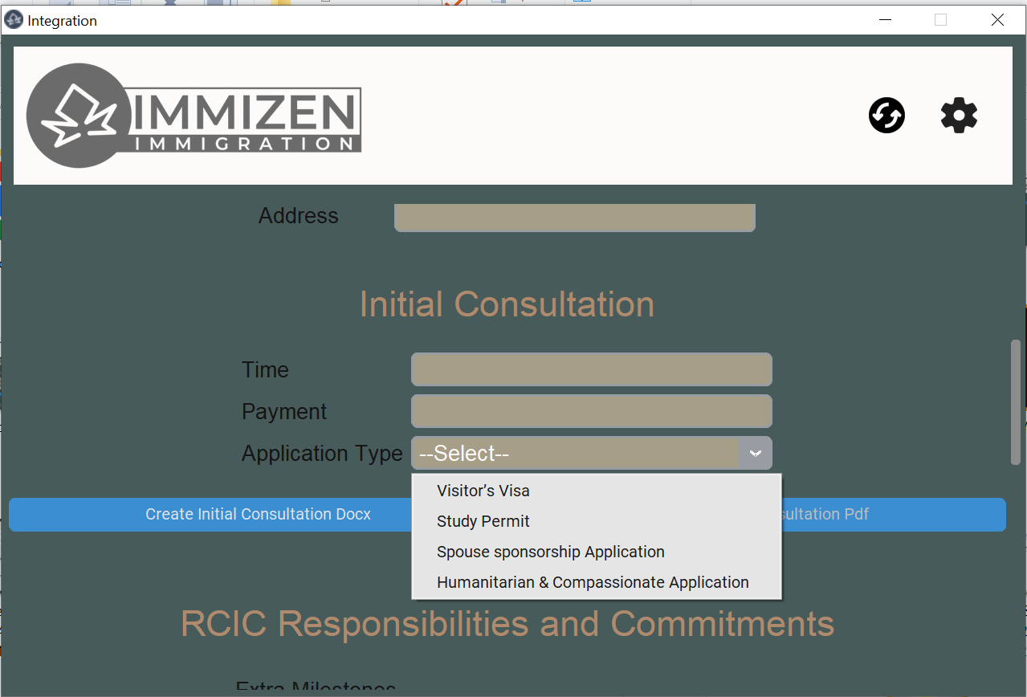
Information for Initial
Consultation
Consultation Time
Consultation Payment
Application type must
have to select
Create Initial Consultation
Agreement in docx with file
name client file number
Create Initial Consultation
Agreement in pdf with file
name client file number
After Docx(For pdf docx is
mandatory)

Slide 7
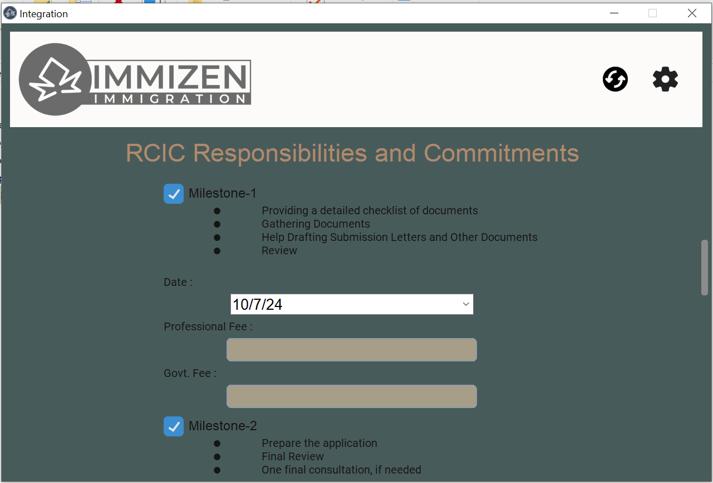
Basic Milestone for specific
Application type
Date of milestone in calendar
Professional Fee of
milestone in Text Box
(Mandatory)
Government Fee
of milestone in Text Box
(Mandatory)
Check Box to select milestone
If you want

Slide 8
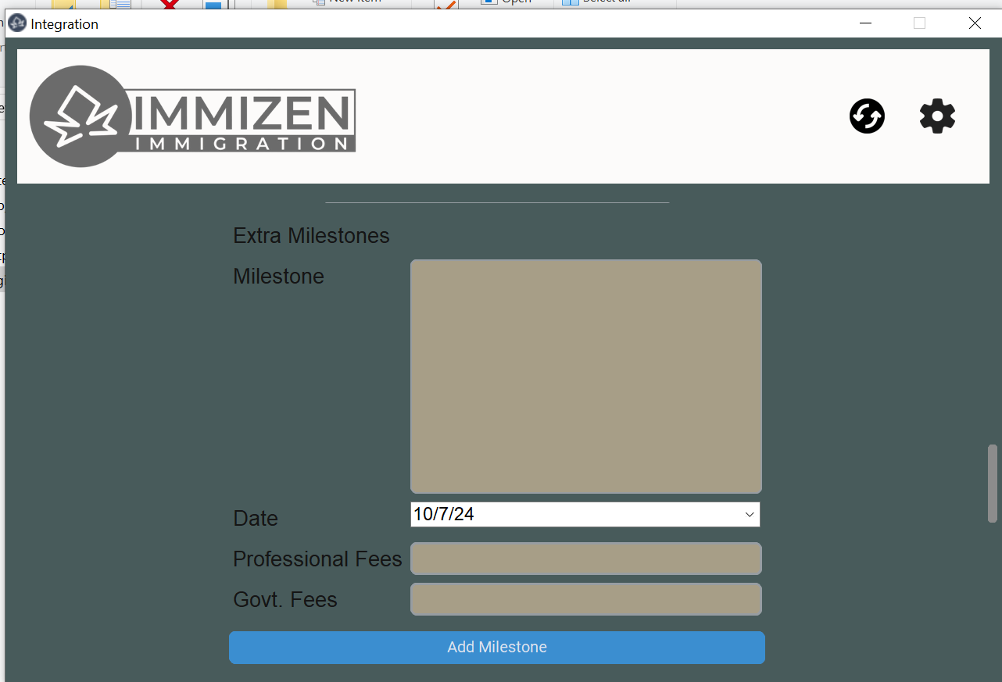
If you need temporary
extra milestone for specific
Client. It will not save.
Write your extra milestone.
Press enter to make new
bullet point for a milestone.
Date for the extra milestone
In calendar
Professional Fee for the extra
milestone in calendar
Government Fee for the
Extra milestone in calendar
Add milestone button to add new extra milestone to
document

Slide 9
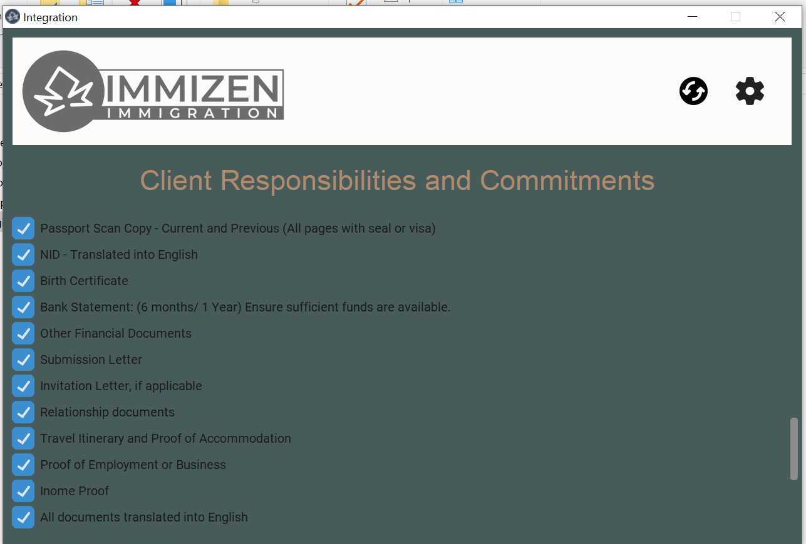
Client responsibilities &
Commitments. Check Box
For select responsibilities.

Slide 10
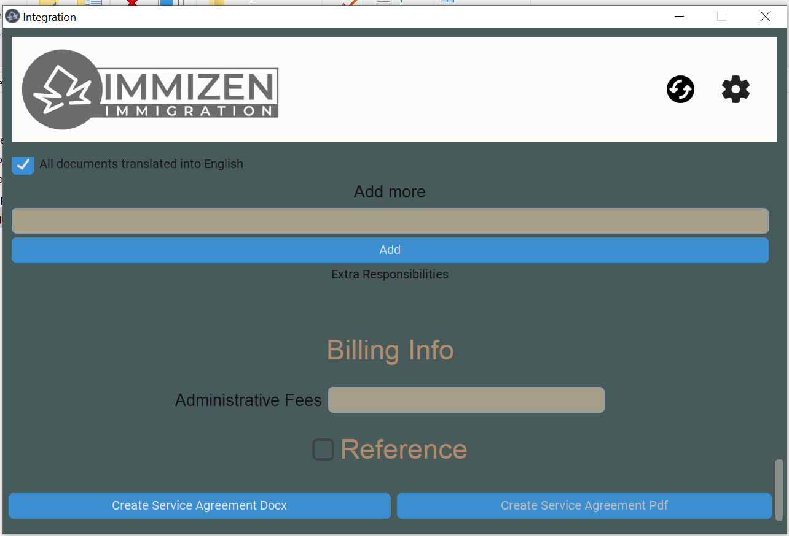
For add new temporary
Responsibilities.
Add Button for add extra
Temporary responsibility.
Administrative Fee Text Box

Slide 11
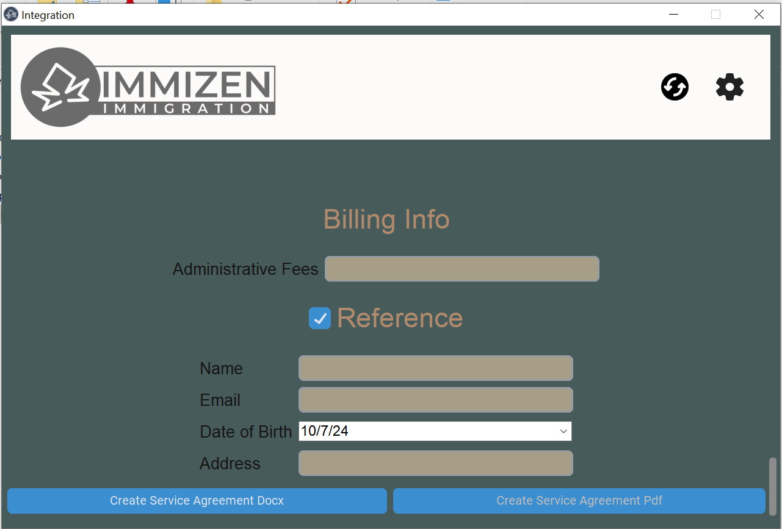
If client has reference then
Select check box for give
information
Reference Name Text Box
Reference Email Text Box
Reference DoB Calendar
Reference Address Text Box
Create Service Agreement
in docx with file name client
file number
Create Service Agreement in
pdf with file name client file
number after Docx (For pdf
docx is mandatory)

Slide 12
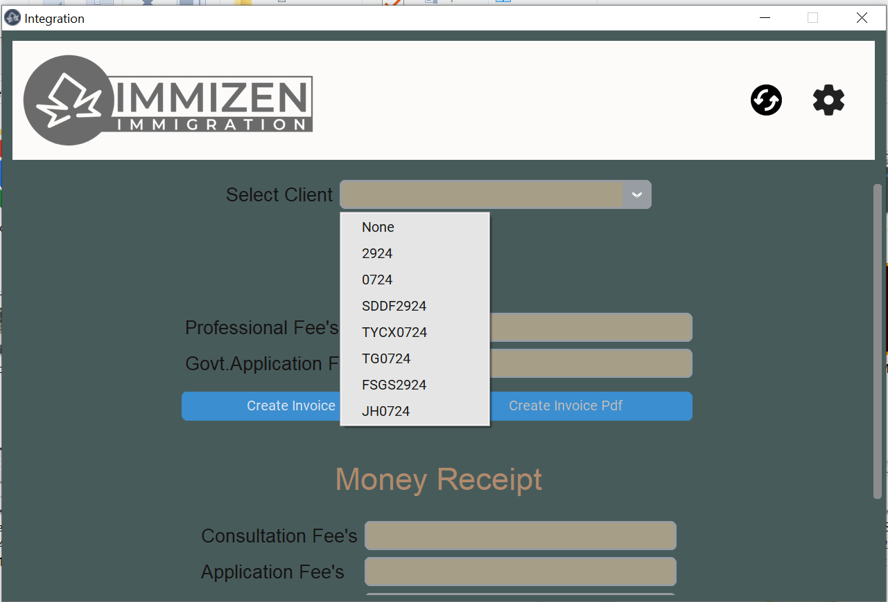
Second Page
Select old client number for
Invoice or money receipt

Slide 13
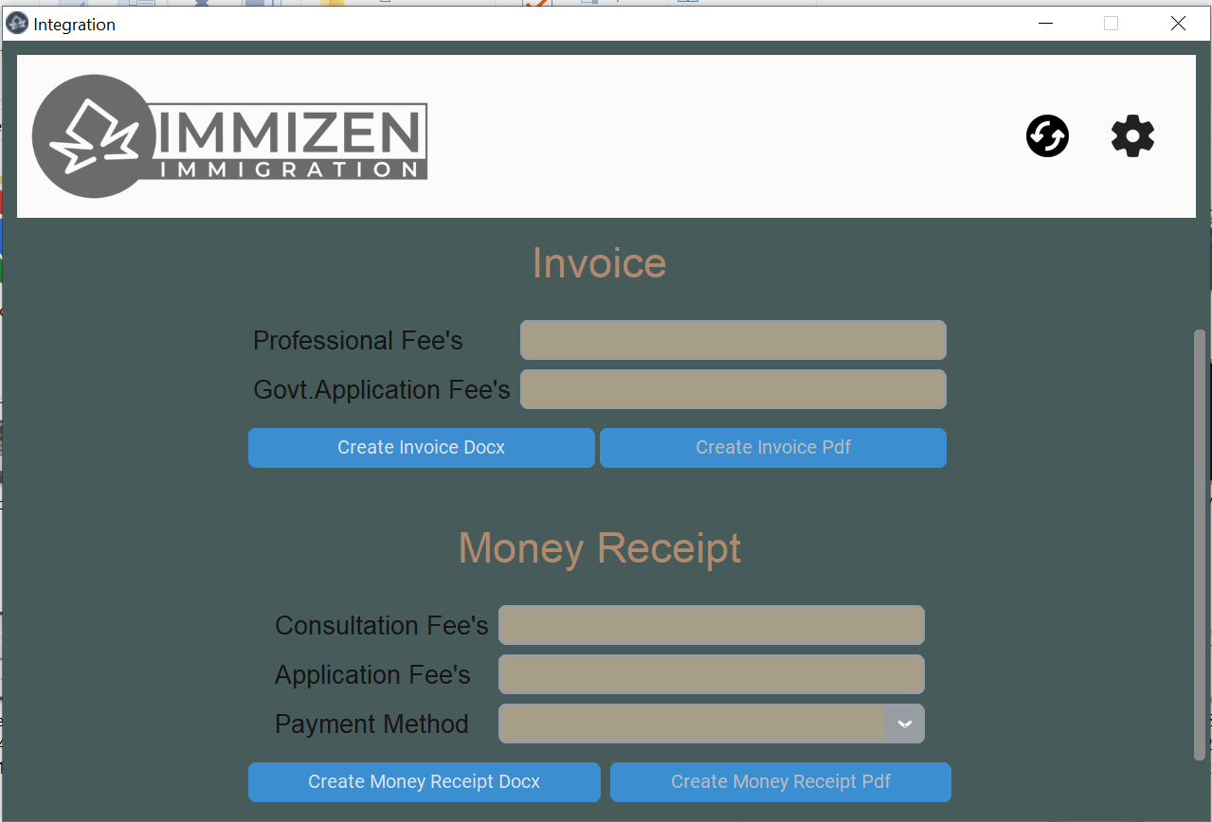
Professional Fee for Invoice
Government Fee for Invoice
Create Invoice in docx with file
name unique file number
Create Invoice in pdf with file
name unique file number after
Docx(For pdf docx is mandatory)
Consultation Fee for Money
Receipt
Application Fee for Money
Receipt
Payment Method for Money
Receipt
Create Money Receipt in docx
with file name unique file
number
Create Money Receipt in pdf
with file name unique file
number after Docx(For pdf docx
is mandatory)

Slide 14
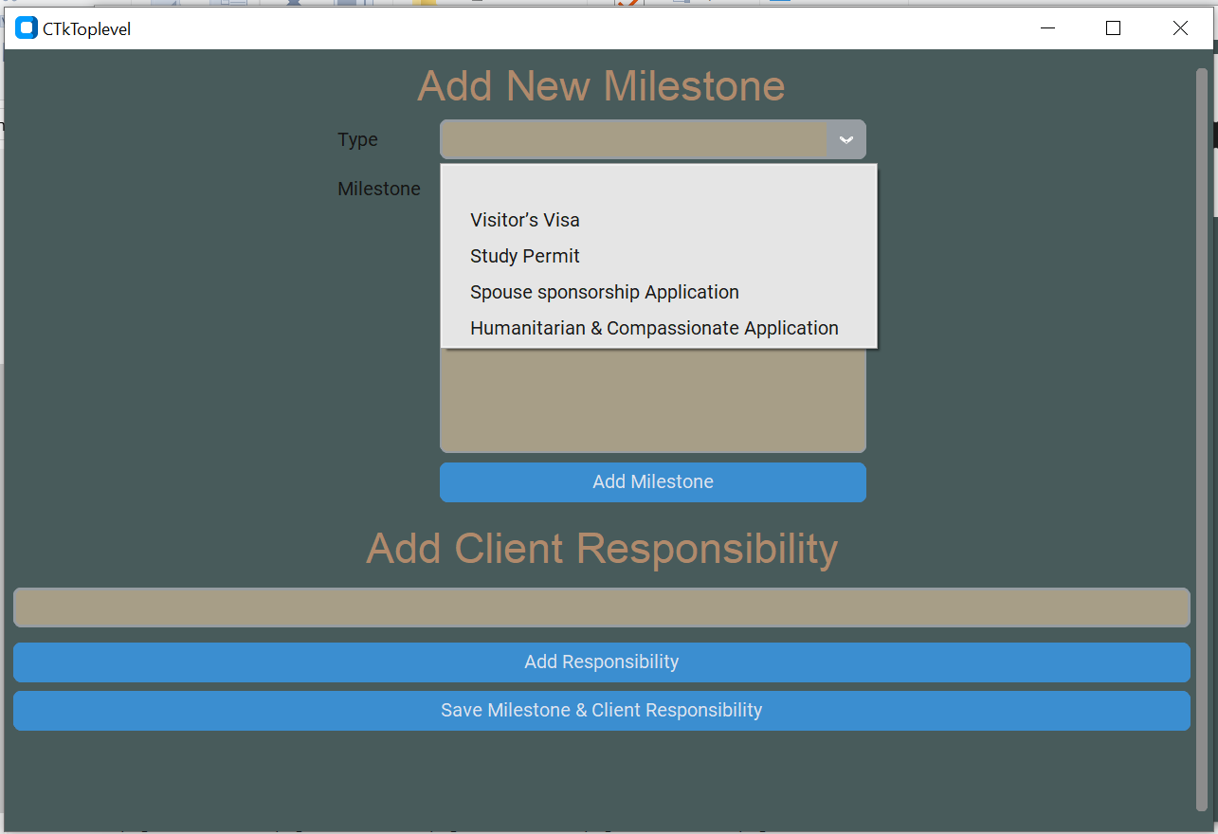
Customization Page
Here you can edit existing
Milestone & Client Responsibilities.
Or you can create new Milestone
& Client Responsibilities
Save Button to save new milestone
In Milestone.xlsx file for further
use

Slide 15
What are the lacking of app?
Without internet you can’t use this app.
It’s runtime & speed depends on internet speed.
Not so smooth like web app because it’s a desktop app.

Slide 16
What you want & what can we fill?
What you want | Can we fill ?
Create docx of Initial Consultation Agreement, Service Agreement, Invoice, Money Receipt. | ☑
Create pdf of Initial Consultation Agreement, Service Agreement, Invoice, Money Receipt. | ☑
Online database for multiple authenticate user can use parallel. | ☑
Can use both windows & mac. | ☑

Slide 17
THANK YOU
We will come with latest version sooner.

